Slide 1
EECS 498 System Design of a Search Engine
Winter 2026
Lab 8: Check In
GSI: Christopher Davis
IA: Rickey Dong
Nicole Hamilton
https://web.eecs.umich.edu/~nham/
nham@umich.edu

Slide 2
agenda
Introduction / announcements
Team Check In

Slide 3
agenda
Introduction / announcements
Team Check In

Slide 4
introduction
Welcome back from break!

Slide 5
introduction
Welcome back from break!
Upcoming Assignments:
Bloom Filter, due 3/22
robots.txt

Slide 6
introduction
Welcome back from break!
Upcoming Assignments:
Bloom Filter
robots.txt
After these two, you’ll have all you’ll need for the Crawler!

Slide 7
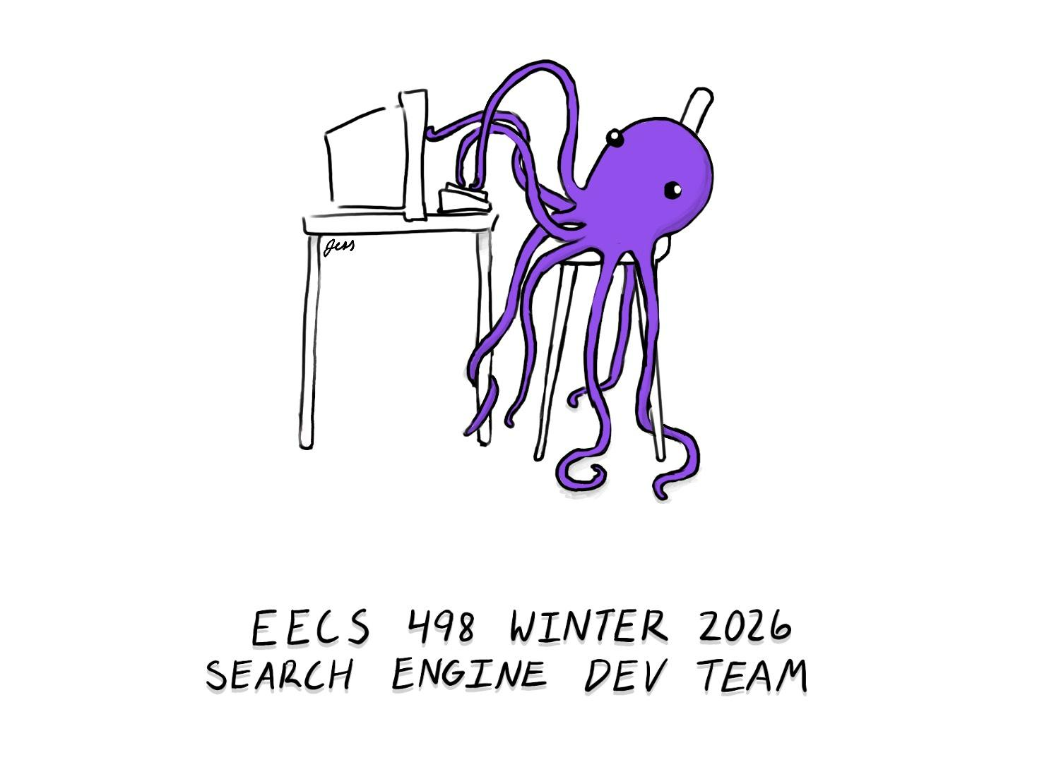
announcement
We will be voting on our mascot’s name!
Poll will be released on EdStem
Ranked-choice voting, just like how we chose the animal

Slide 8
agenda
Introduction / announcements
Team Check In

Slide 9
team check-in
I will now go around to each team to check in.
See where you are with your progress
How you’re splitting up work
What you’ve started implementing
Goals & timelines
Etc.

